Slide 1

Milestone 3
Christa Moncrief
CST-391

Slide 2
Milestone Project Goal
“Product” Supported on MySQL
CRUD Operations
REST API
Biblical Theme (Optional)

Slide 3
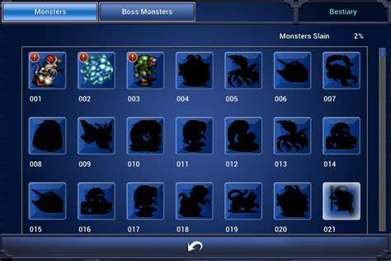
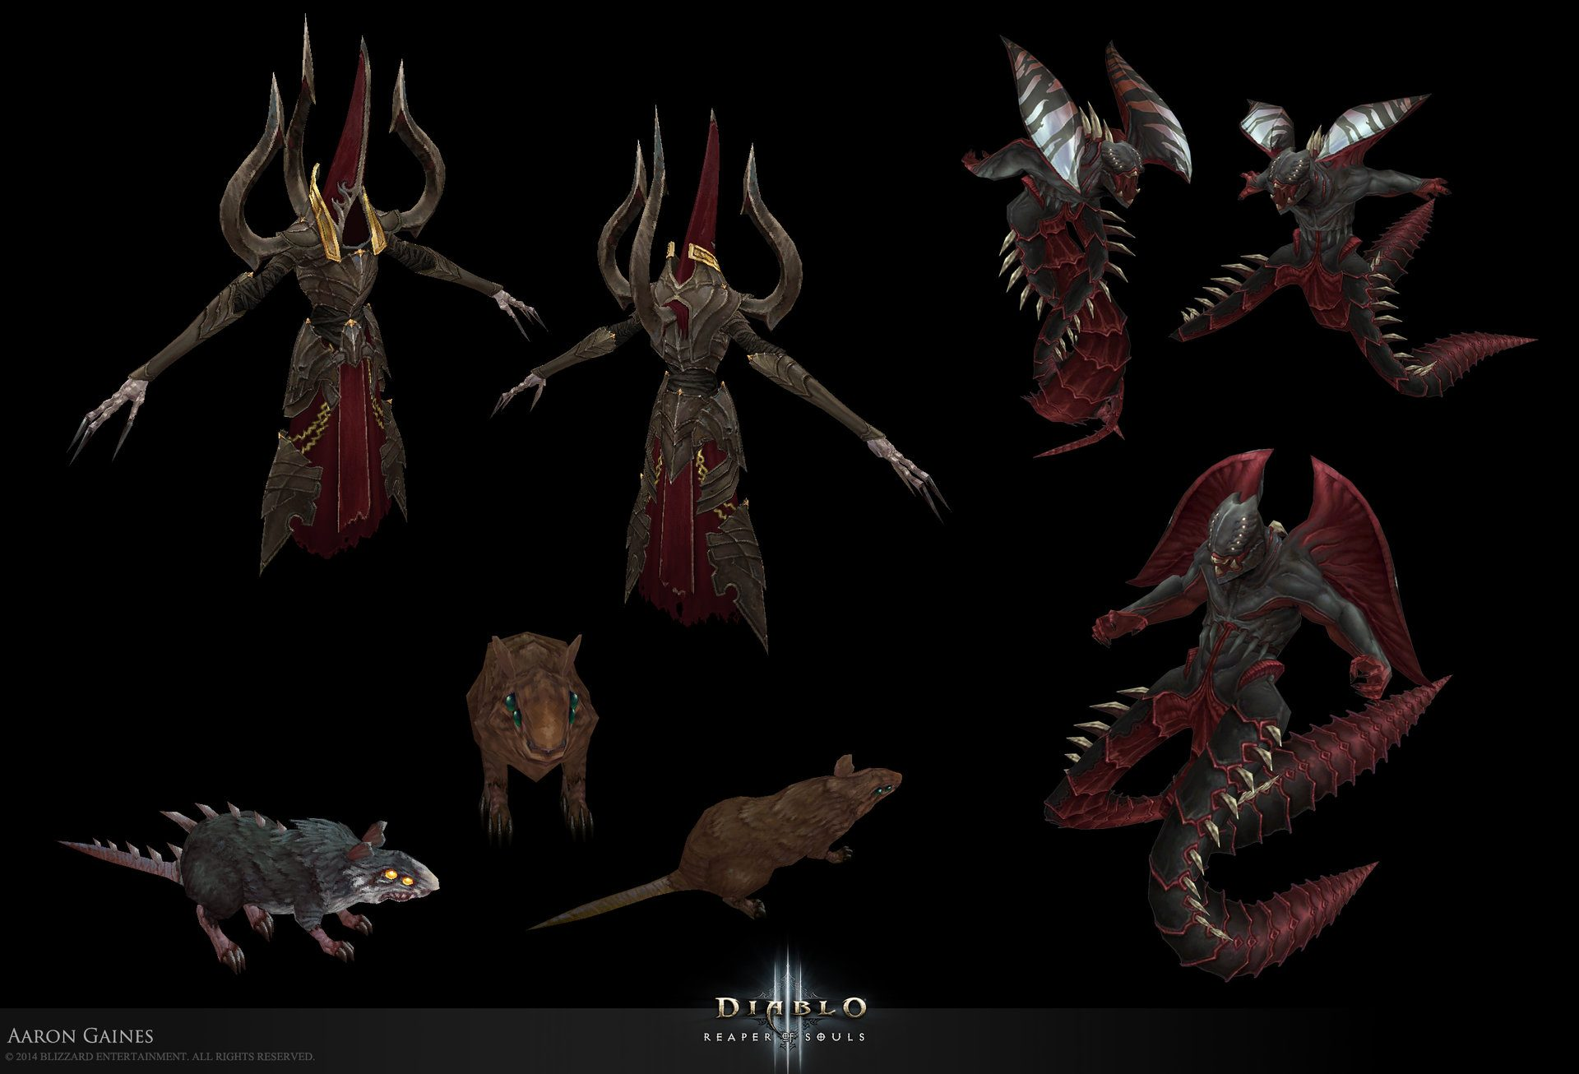
Biblical Bestiary
Final Fantasy
Diablo

Slide 4

Challenges
Time Constraints
Communication with MySQL

Slide 5
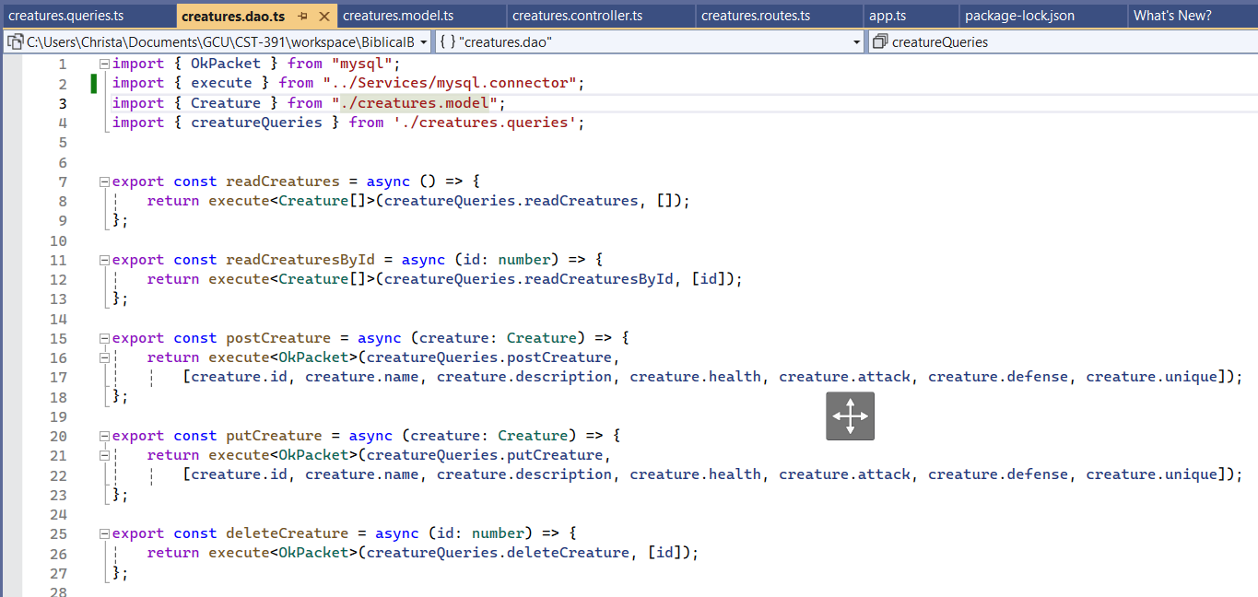
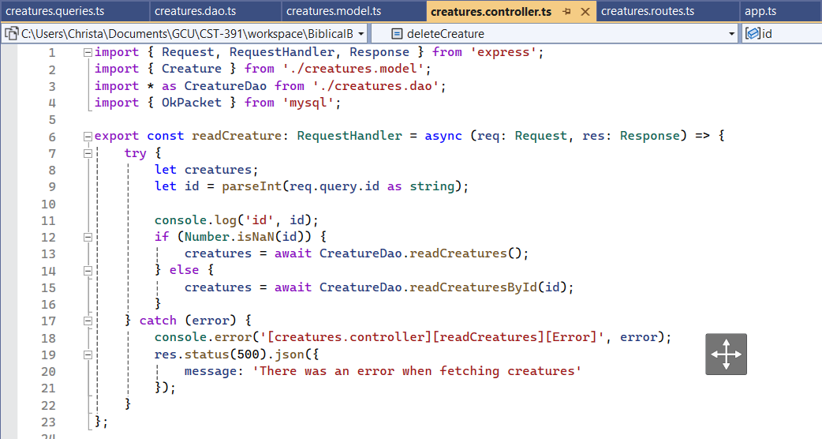
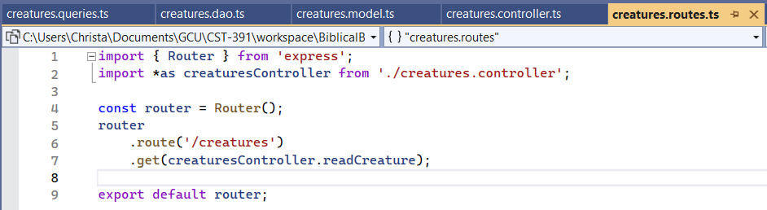
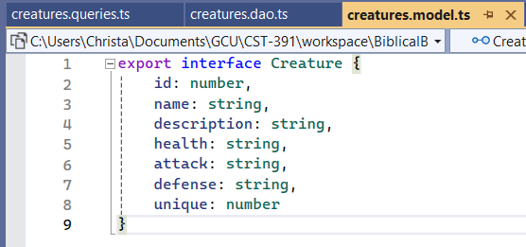
DAO
Controller
Router
Model

Slide 6
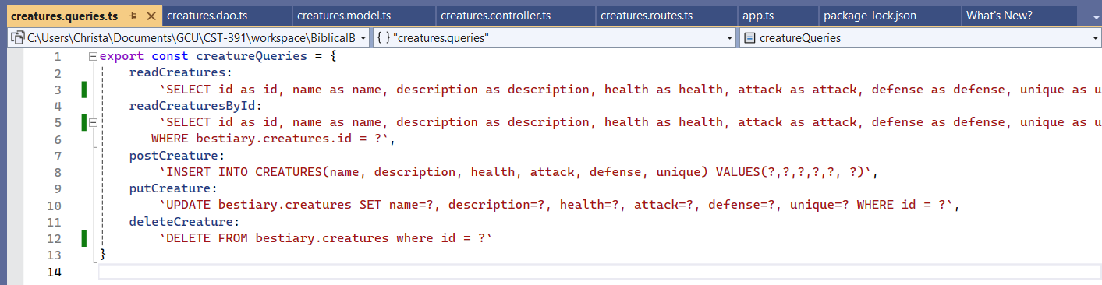
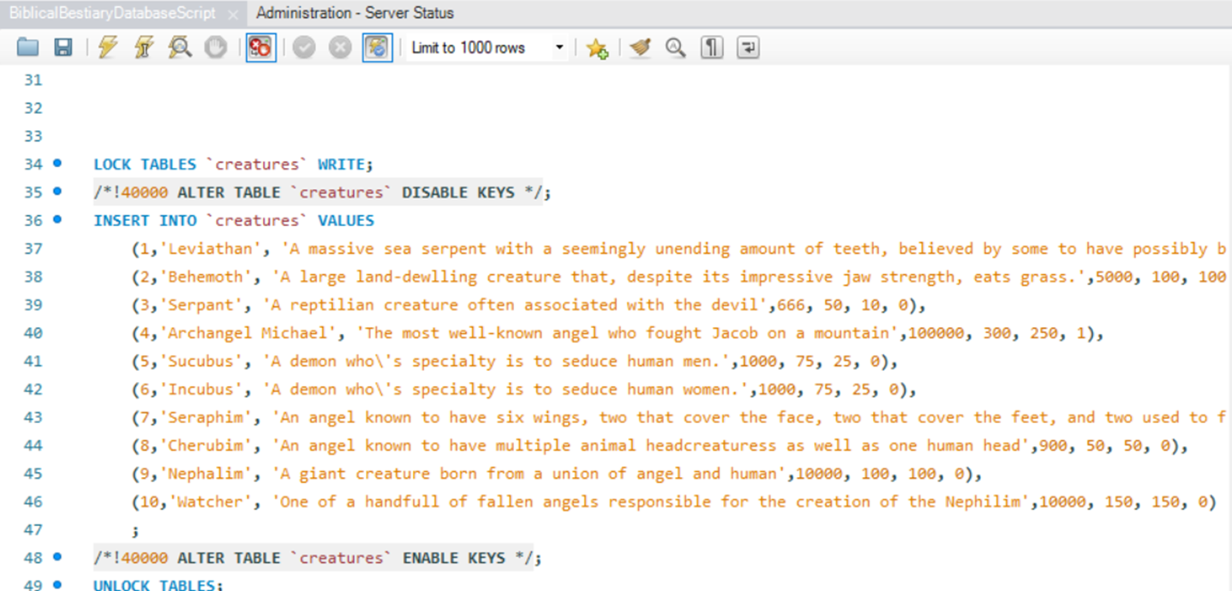

Slide 7

Pending Issues
Communication With MySQL

Slide 8
Thank You!

